Slide 1

“Reducing Power Consumption by Combined Simulation of Massive MIMO and Small-Cells”
Team No: N4
Name | USN
Pragathi Pujari | 01FE20BCS189
B Ajay Kushal | 01FE20BCS289
Lavanya Shahapur | 01FE20BCS185
Kushagra Tomar | 01FE20BCS063
Ashwini Jannu | 01FE20BCS208
Guided by
Mr.Parikshit P Hegde

Slide 2

Problem Statement
“Reducing the Cellular Power Consumption by Combined Simulation of Massive MIMO and Small-Cells”

Slide 3
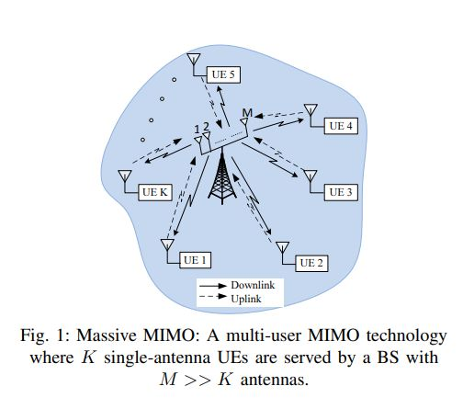
Problem Analysis
An important design criterion for 5G networks is bit-per-joule energy efficiency (EE) defined as Energy Efficiency (EE) = Throughput (R) / Power Consumption (P)
The sum power consumption P, aggregated over UpLink(UL) and DownLink(DL) transmissions in an Massive MIMO system, can be modelled as P = P_{PA} + P_{C} + P_{sys} where
P_{PA} - power consumed by the power amplifiers (PAs) at the Base Station and the SCAs
P_{C} - circuit power expenditure at the Base Station and the SCAs
P_{sys} - the remaining system-dependant component in P

Slide 4
Massive MIMO and small cells
Two main approaches that we have currently investigated:
Massive MIMO: Deploy large-scale antenna arrays at existing macro base stations (BSs). This enables precise focusing of emitted energy on the intended users, resulting in a much higher energy efficiency.
Small-cell Access Points: Deploy an overlaid layer of small-cell access points (SCAs) to offload traffic from BSs, thus exploiting the fact that most data traffic is localized and requested by low-mobility users. This approach reduces the average distance between users and transmitters, which translates into lower propagation losses and higher energy efficiency.

Slide 5
Objectives / Goals
To minimize the total power consumption while satisfying Quality-of-Service (QoS) constraints at the users and power constraints at the Base Station and Small cells.
To provide promising simulation results showing total power consumption can be improved by combining massive MIMO and small cells.
To compare and analyse the results of the proposed algorithm with other beamforming algorithms.

Slide 6
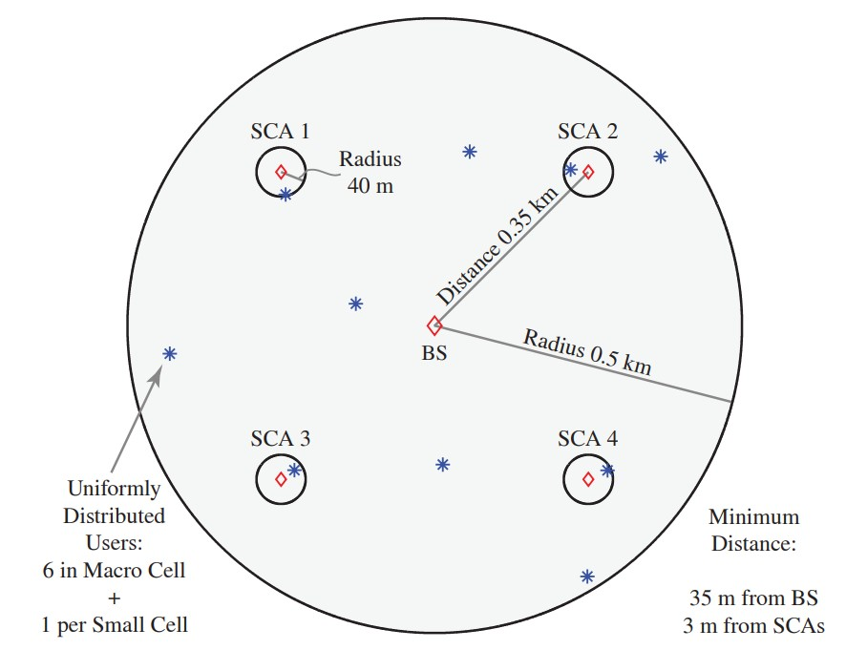
Approaches Used
1) Optimal Beamforming using only BS
2) Optimal Spatial SoftCell coordination
3) Low Complexity RZF Beamforming
Fig. Diagrammatic representation of the scenario with MIMO and Small Cells

Slide 7
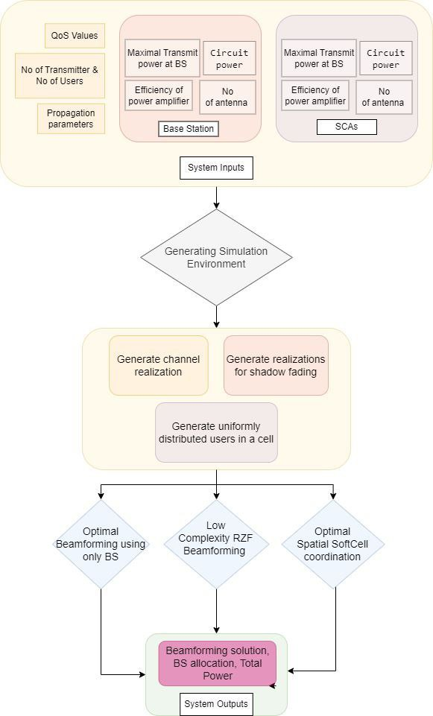
Flow Chart
Inputs to the modules include
Channel realization
No of antennas at each transmitter
SINR constraints
Weight Matrices
Maximal power corresponding to each power constraints
Fig. Architecture Design of the System

Slide 8
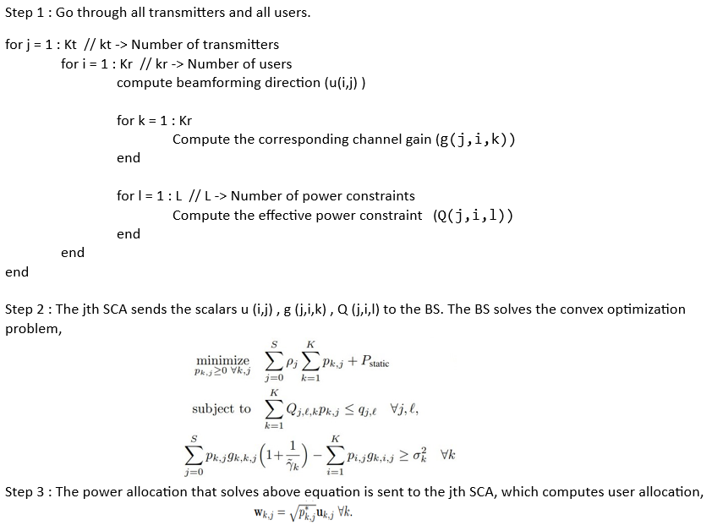
Algorithm Design

Slide 9
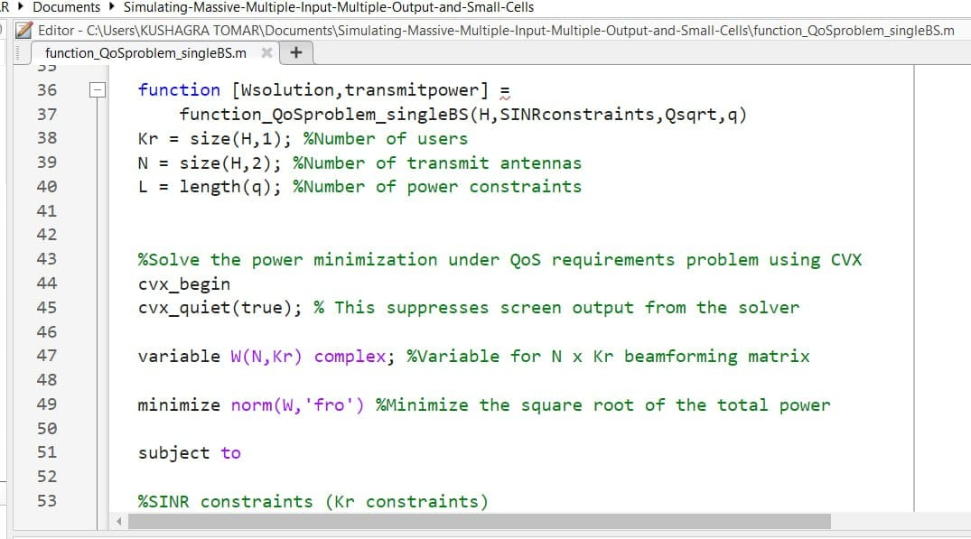
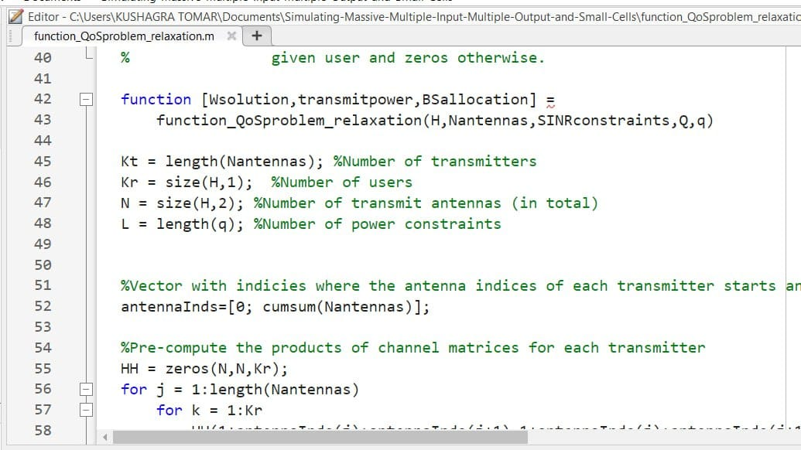
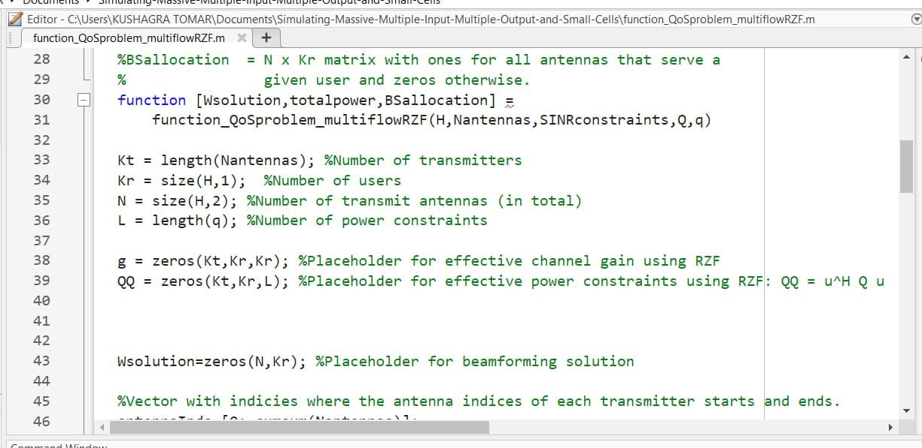
Implementation
Fig. Optimal Beamforming using only BS module
Fig. Optimal Spatial SoftCell coordination module
Fig. Low Complexity RZF Beamforming module

Slide 10
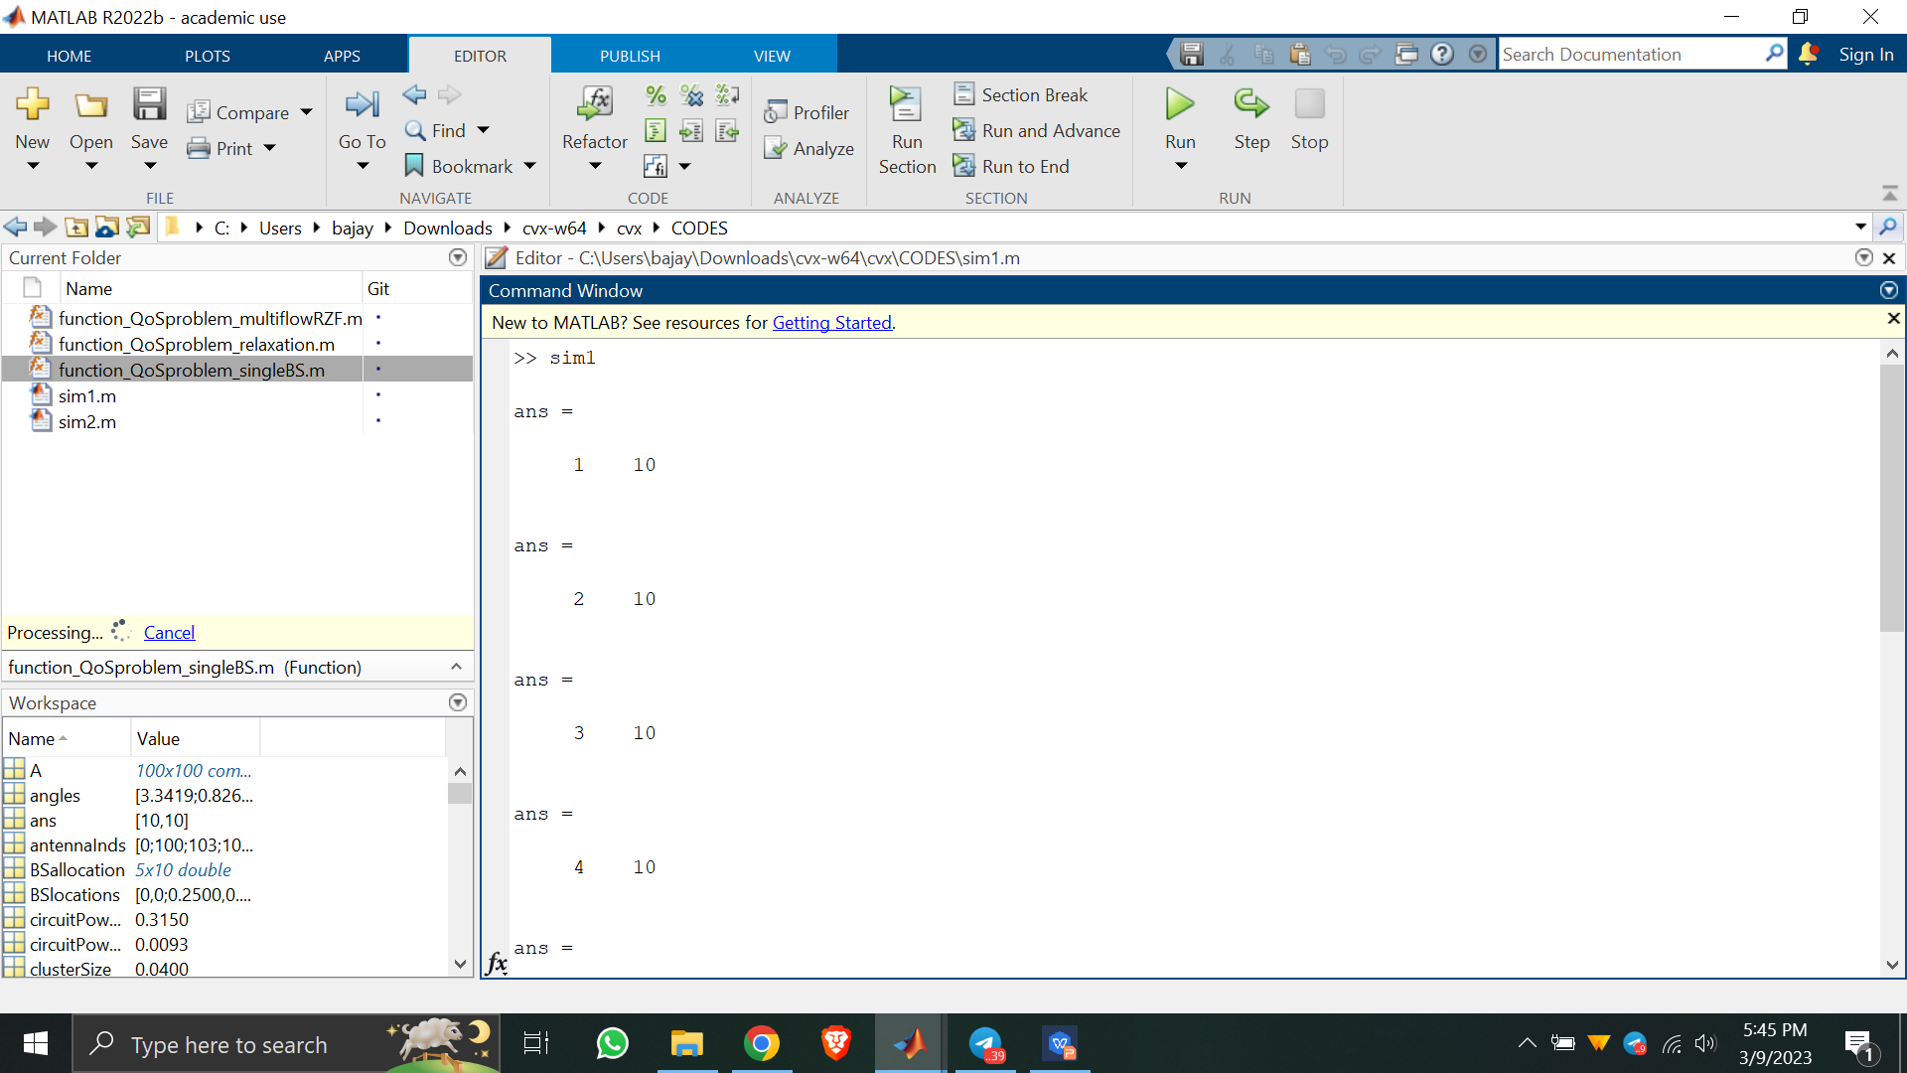
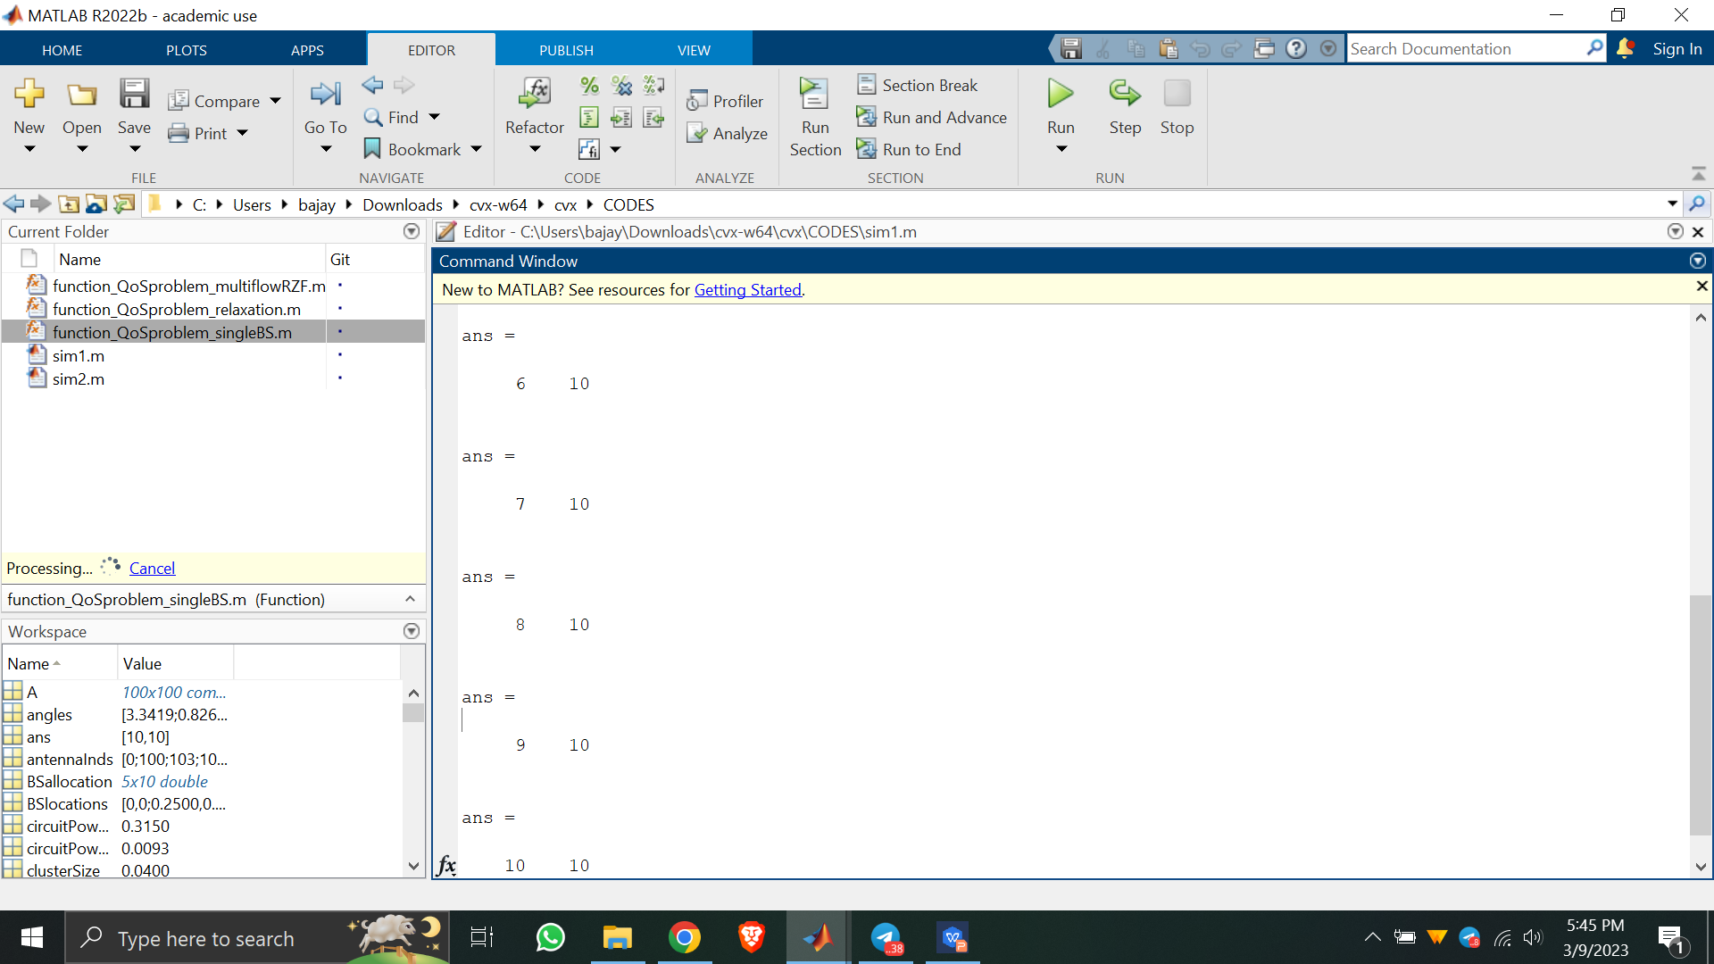
Result Analysis
Fig. This figure depicts the completion of simulation for all 10 users.

Slide 11
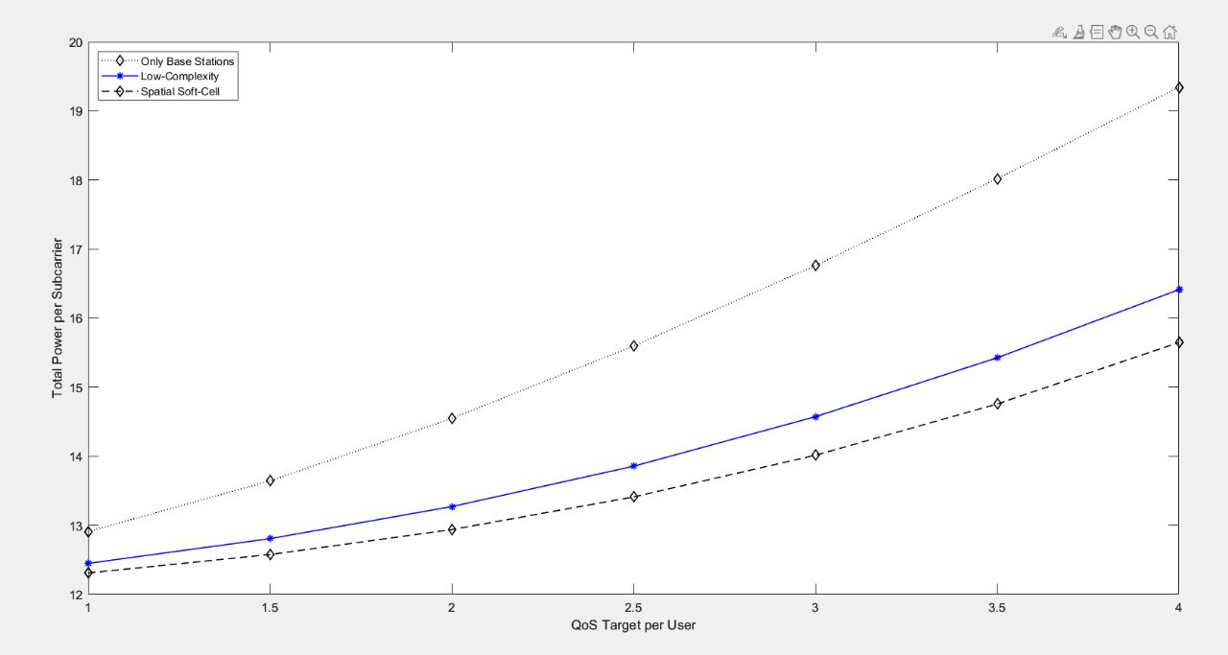
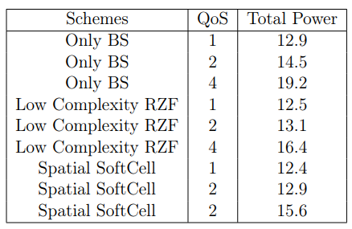
Result Analysis
Fig. Base graph plotted for the different schemes for varied QoS

Slide 12
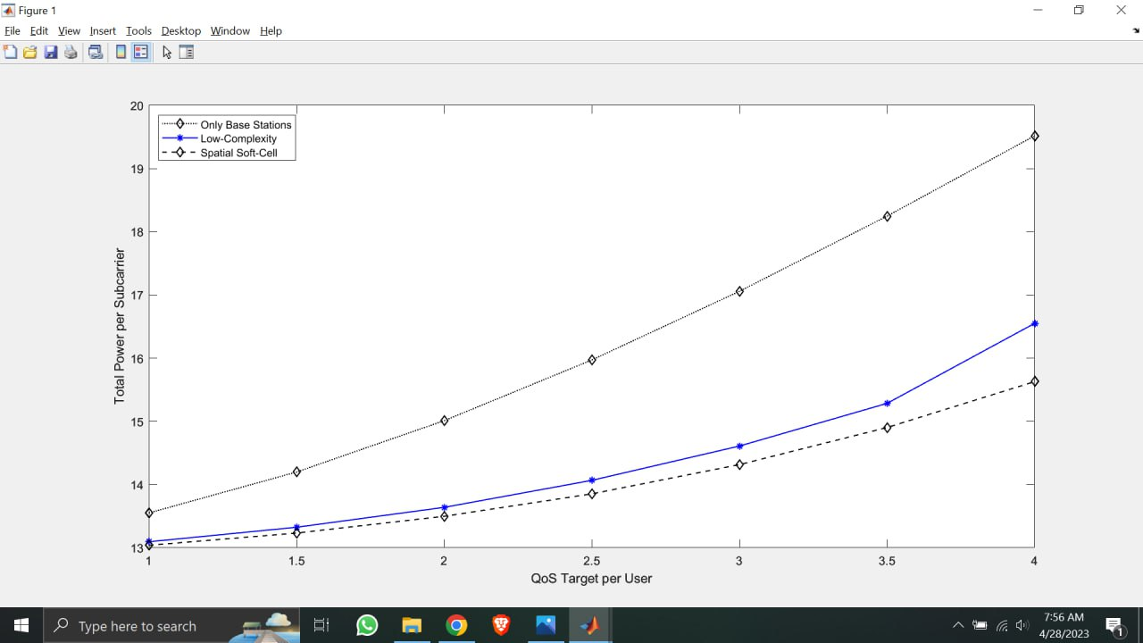
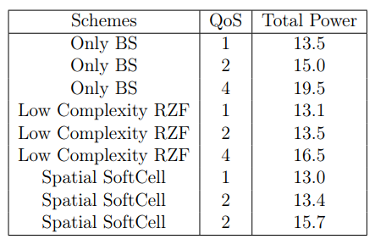
Result Analysis
Fig. Graph A obtained for increased values of transmit power and No of antennas
Here, the number of antennas placed at the base station and the SCAs is increased by a gradual amount, while the maximal transmit power per subcarrier at the BS and SCAs are also increased gradually.

Slide 13
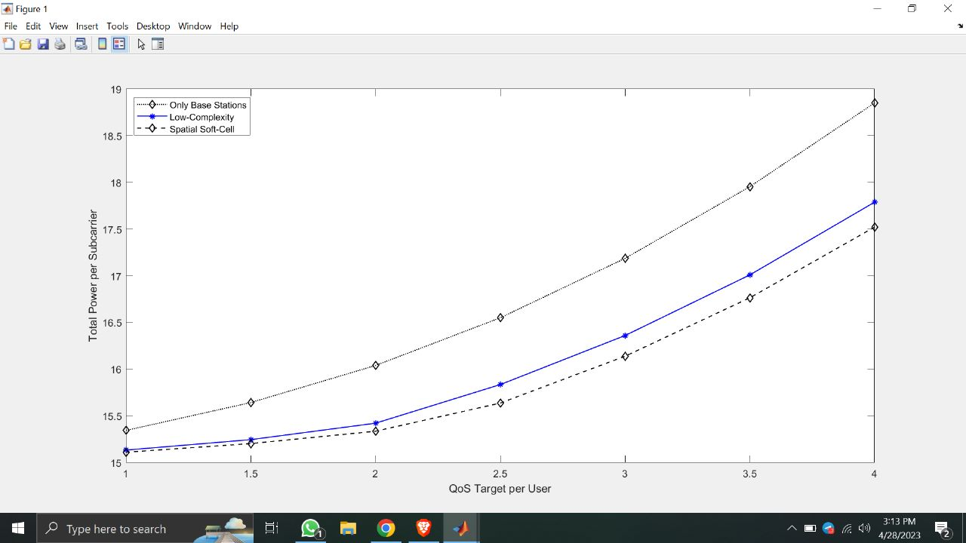
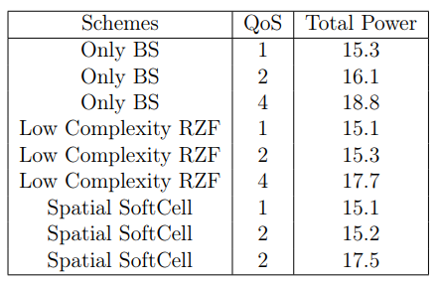
Result Analysis
Fig. Graph B obtained for doubled values of transmit power and No of antennas
Here, the number of antennas placed at the base station and the SCAs is doubled, while the maximal transmit power per subcarrier at the BS and SCAs are decreased gradually

Slide 14
Conclusion
The total power of Only BS to achieve the required QoS is higher than the Low Complexity RZF and Spatial Soft Cell approach, due to high amount of power required to overcome the interference.
We can achieve same Quality of Service (QoS) requirements with reduced total power with both Low Complexity RZF algorithm and Spatial Soft Cell usage.
The total power of Low Complexity RZF is slightly more than the Spatial Softcell because of its high complexity and computational requirements. Still this approach is better due to its ability to mitigate user interference making it practical for real world applications.

Slide 15
THANK YOU

